Slide 1

Azure Cosmos DB Fast, distributed NoSQL and relational database for any scale

Slide 2






Modern life is app-centric
Modern life is app-centric
Today’s apps deliver innovation in all facets of life
Today’s apps deliver innovation in all facets of life
Notes:
Modern life is app-centric: businesses are reliant on applications and, increasingly, so are our homes and personal lives. For businesses, innovation is brought to life through apps as we find new ways to remain competitive and ensure business continuity during uncertain times.

Slide 3

Apps run on data
Apps run on data
Real-time data from different sources and in different forms power modern apps
Real-time data from different sources and in different forms power modern apps
Notes:
As apps have become mission-critical at work and home, so, too, has data. Apps exist to use and move data; without it, apps offer little functionality and usefulness.

Slide 4

Developers have new requirements
Developers have new requirements
Today, devs need the flexibility to enable rapid app development, the responsiveness to manage changes, and the ability to handle high data volumes
Today, devs need flexibility, responsiveness, and the ability to handle high data volumes
Notes:
This means that application developers need to leverage data in new ways.
Today, devs need the flexibility to enable rapid app development, the responsiveness to manage changes, and the ability to handle high data volumes.

Slide 5

Modern app devs need modern databases
Modern app devs need modern databases
Notes:
To meet these requirements, developers need new kinds of databases that can address the evolving requirements of modern cloud apps. Distributed databases were created to address these unique challenges:
High volumes of data
Data from many disparate sources
Dynamic schema to manage lots of different types of data
Consistent scalability, availability, and elasticity
Distributed SQL databases are an emerging class of databases that provide the horizontal scalability of NoSQL systems, combined with relational capabilities. They were created to enable developers to apply the strengths of relational databases without sacrificing scalability, availability, and elasticity required for modern cloud apps.

Slide 6
Propel your app development into the future with Azure Cosmos DB
Guaranteed performance at any scale
Simplified app development
Mission-critical ready
Fast, distributed NoSQL and relational database for any scale
Fully managed and cost-effective

Slide 7




Azure Cosmos DB powers real-time apps anywhere in the world
IoT device telemetry
Personalization and recommendations
Multi-tenant SaaS
Global, mission-critical
Notes:
These capabilities make Azure Cosmos DB ideally suited for modern application development, especially applications that: experience unpredictable spikes and dips in traffic, generate lots of data, need to scale to millions of tenants while delivering real-time user experiences, and are depended upon for business continuity.
Some of the most popular use cases for Azure Cosmos DB include IoT device telemetry, real-time personalization, serving dispersed user bases with high concurrent activity, and apps that are transactional in nature, such as online e-commerce, ad networks, and finance.
As an example that’s relevant to your business, let’s talk about <Speakers - jump to customer story best suited to your audience>

Slide 8
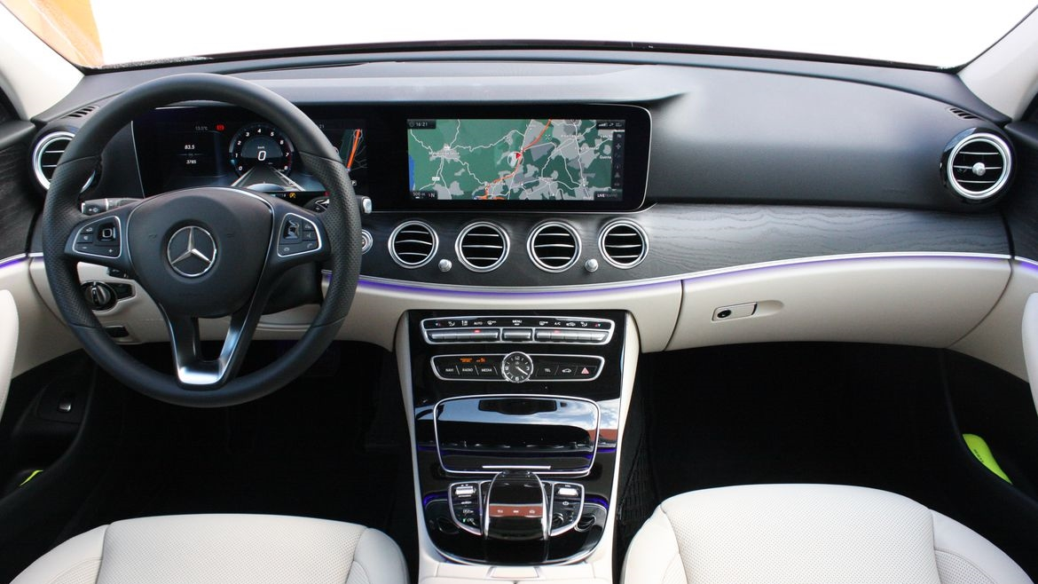

Mercedes-Benz (1 of 2)
Mercedes-Benz (1 of 2)
A cloud-native IoT solution for an in-car digital experience that runs on Azure Cosmos DB and Azure Kubernetes Service
Azure Cosmos DB delivers:
Global data distribution
High availability
Low latency reads and writes worldwide

Slide 9
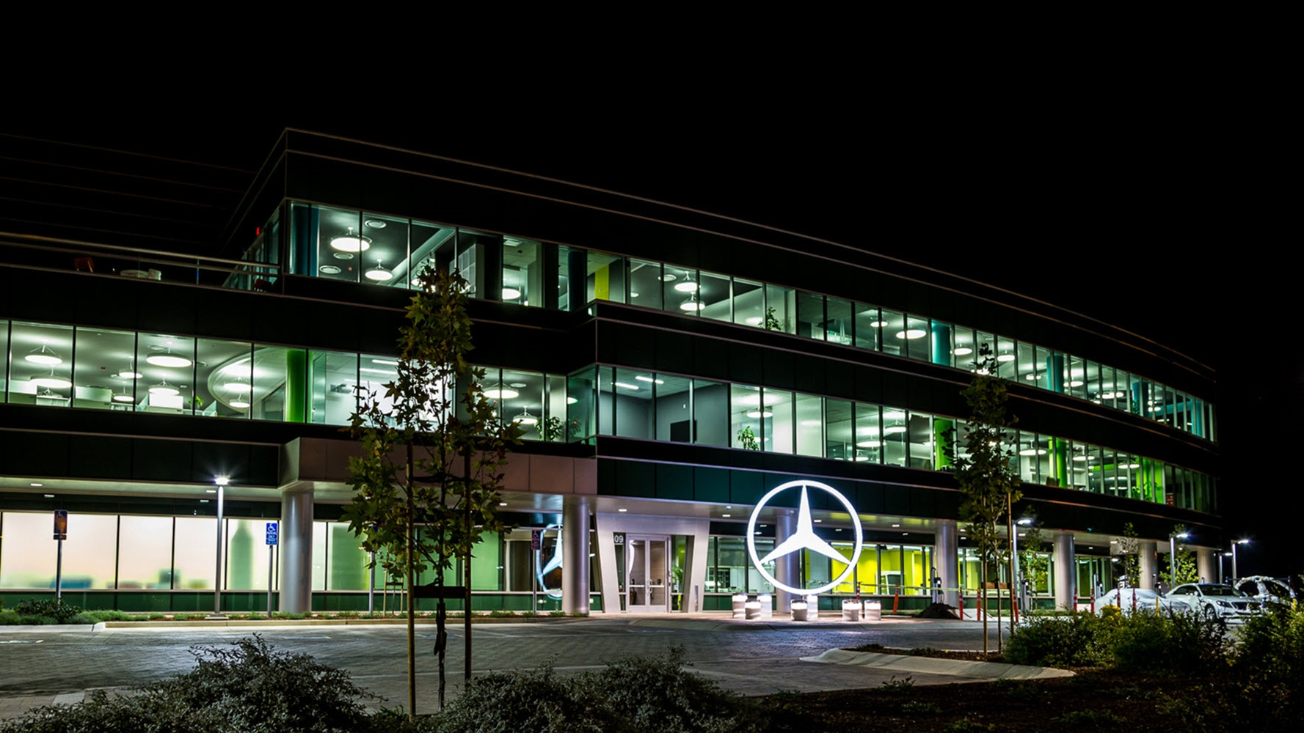
Mercedes-Benz (2 of 2)
“Our software development process is so much better now. We’re able to keep the software inside of the cars updated and release new features in weeks instead of months, while preserving quality and security of vehicle and driver data.”
Rodrigo Nunes
Principal software engineer, Mercedes-Benz, R&D

Slide 10
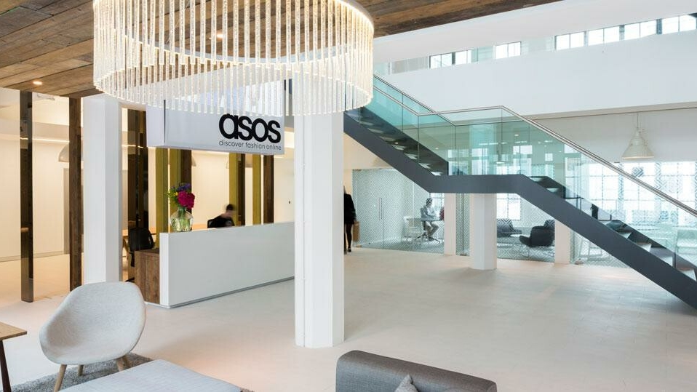

ASOS (1 of 2)
ASOS (1 of 2)
Real-time product recommendations and instant order updates for 26mm+ global customers.
Azure Cosmos DB delivers:
<10 ms latency reads and writes
Global data distribution
Instant elastic scalability
Change feed for order workflows and microservices
Notes:
Challenge
ASOS ecommerce platform needed to offer real-time product recommendations and scale to meet seasonal demand and instant update with high reliability in any location.
Outcome Reimagined microservices architecture in a global distribution of 30 datacenters that ensures automated resiliency and high levels of performance for customers in any location, and a recommendations platform for 26mm+ customers includes 85,000 products, with 5,000 new ones added each week.
ASOS uses Azure Cosmos DB across numerous microservices, including:
low-latency data store for tasks such as storing and retrieving precalculated user profiles and product machine learning models to generate real-time recommendations
Order workflows using change feed functionality to broker communication between event-driven microservices that handle various stages of the order workflow as a persistent event store, so customers can easily track their orders
easy-to-use online returns process. Customers can request a return online, download the return label, and get refunded with just a few easy steps
Highly scalable distributed order processing workflow that has gone from processing tens of orders per second to hundreds of orders per second (ASOS was able to process 95 million orders in FY21 with Azure Cosmos DB)

Slide 11

ASOS (2 of 2)
“We chose Azure Cosmos DB because of its global distribution and ability to handle heavy seasonal bursts like Black Friday.”
Bob Strudwick
Chief Technology Officer

Slide 12


Coca-Cola (1 of 2)
Coca-Cola (1 of 2)
A sales revenue solution gathers data from business units across 200+ countries, for insights in minutes.
Azure Cosmos DB delivers:
Global data distribution
Ingestion of PBs of data
Unlimited scale
Enterprise-grade service
Notes:
https://youtu.be/DqQuXGjaE8c

Slide 13

Coca-Cola (2 of 2)
“Being able to scale and have insights that are delivered within minutes is very important to us”
Neeraj Tolmare
CIO and Global Head of Digital & Innovation, The Coca-Cola Company

Slide 14
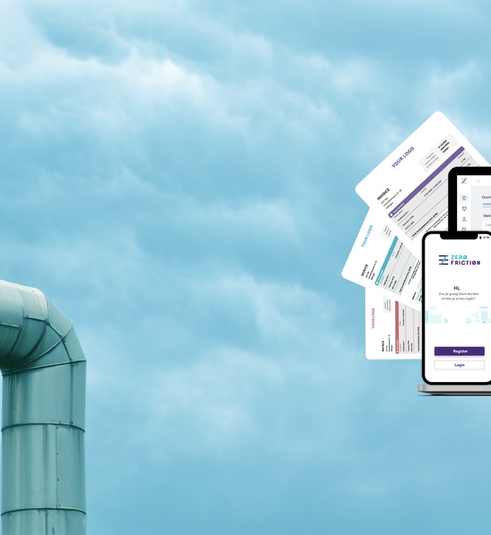

Coca-Cola (1 of
Zero Friction
SaaS platform that provides efficient heat metering and billing for heat suppliers and ~12,000 end customers.
Azure Cosmos DB delivers:
Massive scale
Support for major traffic spikes
SLA-backed high availability
Cost efficiency with serverless and multitenant billing
Notes:
https://youtu.be/DqQuXGjaE8c
Microsoft Customer Story-Zero Friction delivers frustration-free metering and billing to the energy sector with Azure Cosmos DB

Slide 15

Zero friction
“We’ve built a unique solution for our industry because we use a SaaS concept, which makes it very affordable and scalable.”
Yoni Nijs
Cofounder, CTO, and Product Lead, Zero Friction

Slide 16
Azure Cosmos DB
Develop modern apps with a fully managed and serverless distributed database, offering SLA-backed speed and availability for NoSQL data, and support for open-source PostgreSQL, MongoDB, and Cassandra.
Guaranteed performance at any scale
Simplified app development
Mission-critical ready
Fully managed and cost-effective
Gain unparalleled SLA-backed availability, speed and throughput for NoSQL data, fast global access, and instant elasticity.
Build fast with multiple SDKs and support for open-source PostgreSQL, MongoDB, Apache Cassandra, and more. Gain insight over real-time data with no-ETL analytics using Azure Synapse Link.
Guaranteed business continuity, up to 99.999% availability, and enterprise-level security for every application.
End-to-end database management with serverless and automatic scaling options to match your application and TCO needs.

Slide 17
Guaranteed performance at any scale
Real-time access with <10 ms read and write latencies backed globally by SLA for NoSQL data
The only service with financially-backed SLAs for millisecond read and write latency at the 99th percentile and 99.999% high availability for NoSQL data
Turnkey multi-region writes and data distribution to any Azure region with the click of a button
Independently and elastically scale storage and throughput across any Azure region
Latency
High Availability
<10 ms
99th percentile
Up to
99.999%
Throughput
Consistency
Guaranteed
Guaranteed
Notes:
Support for all PostgreSQL data types with SLA-backed 99.95% availability across over 25 Azure regions

Slide 18
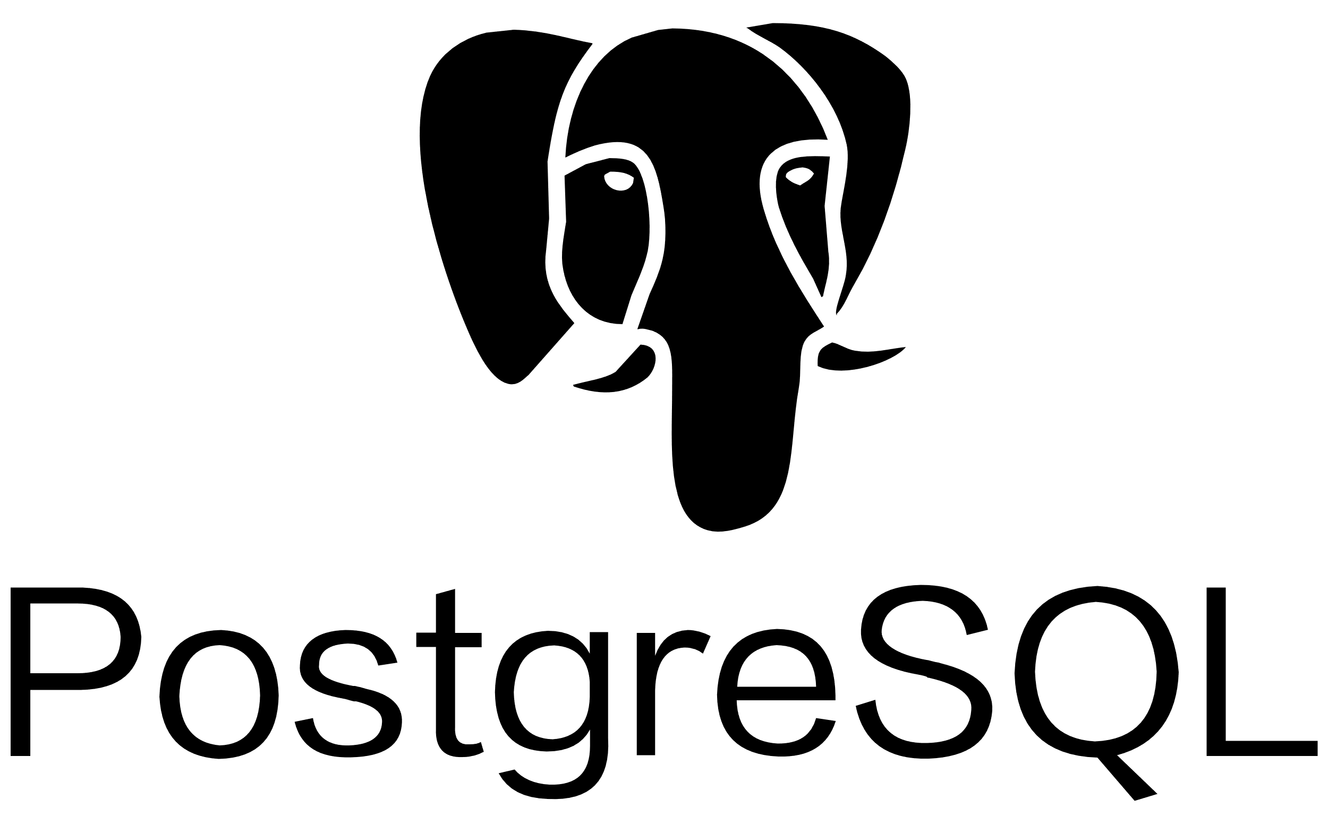
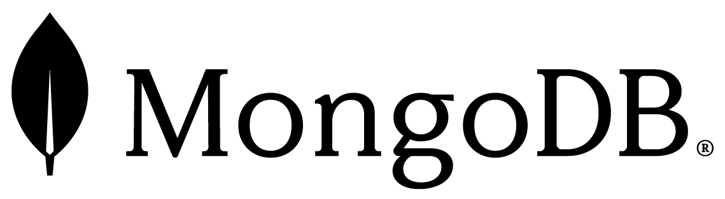



Simplified app development
Azure Cosmos DB for:
Easily build cloud-native apps with a single distributed database service for both relational and NoSQL data:
Offers scalability and performance with native NoSQL service, and MongoDB- and Cassandra-compatible options.
Supports native, open-source PostgreSQL, with ACID compliance, rich SQL querying, and PostgreSQL extensions.
Integration with Azure Synapse Analytics, Azure Kubernetes Service, and Azure Functions
SDKs for .NET, Java, Python, and Node.js
Change feed to easily track and manage changes to database containers
Automatic indexing of all your data
Run advanced analytics over real-time data with Azure Synapse Link
NEW!
NoSQL
Table
Notes:
Azure is the first cloud provider to offer a single database service with support for both relational and NoSQL data.
Service offers superior scalability and performance with native NoSQL service, and compatibility with NoSQL databases including MongoDB, Cassandra, and Gremline.
Now with PostgreSQL support, Azure Cosmos DB for PostgreSQL blends the scalability of a NoSQL database with ACID transaction compliance, a rich SQL programming model, and support for Postgres extensions.
Integration with cloud-native Azure app development and analytics services including Azure Synapse Analytics, Azure Kubernetes Service, and Azure Functions
Popular languages and SDKs for .NET, Java, and Python
Change feed to easily track and manage changes to database containers
Automatic indexing of all your data, regardless of data model
Run advanced analytics over real-time data without ETL using Azure Synapse Link

Slide 19
Mission-critical ready
Azure Cosmos DB offers a comprehensive suite of SLAs including up to 99.999% availability worldwide
Azure Cosmos DB delivers zero downtime with 0 RPO
Continuous back up and point-in-time restore
Enjoy enterprise-grade end-to-end encryption and self-managed keys
Role-based access control keeps your data safe and offers fine-tuned control

Slide 20
Fully managed and cost-effective
Automatic maintenance and updates
Serverless and autoscale options keep costs low by matching resources to demand, and eliminating capacity management and over-provisioning
Cost-effective serverless model is ideally suited for small, spiky workloads with moderate performance requirements
Autoscale provisioned throughput model guarantees high-performance for critical workloads and offers cost controls
Scale up and/or scale out to optimize for different classes of workloads

Slide 21
Ease the challenge of NoSQL migration with Azure
Make data modernization easy with seamless migration of NoSQL workloads to cloud
Azure Cosmos DB for Mongo DB, Azure Cosmos DB for Apache Cassandra, and Azure Cosmos DB for NoSQL bring app data from existing NoSQL deployments
Leverage existing tools, drivers, libraries, and extensions, and continue using existing apps’ current SDKs
Turnkey geo-replication
No infrastructure or VM management required
Cassandra
MongoDB
DynamoDB
Couchbase
Neo4j
NoSQL wire protocol
Azure Cosmos DB for:
MongoDB Apache Cassandra NoSQL
HBase
CouchDB

Slide 22


Norton LifeLock (1 of 2)
Norton LifeLock (1 of 2)
Migrated from Cassandra for cyber security software that protects more than 40 million endpoints in 150 countries, and receives 15 billion requests a day.
Azure Cosmos DB delivers:
Azure Cosmos DB for Apache Cassandra
99.999% availability SLA
Elastic and instant scalability
Notes:
Symantec Corp. is migrating its databases from Cassandra to Azure Cosmos DB. The company, based in Mountain View, California, is already saving 40 percent on the cost of running its databases, and its teams spend less time managing data and more time building security products. With Azure Cosmos DB, Symantec can help ensure high availability for services that monitor 40 million endpoints in 150 countries, responding to 15 billion requests a day in less than one second.
https://customers.microsoft.com/en-gb/story/symantec-professionalservices-azurecosmosdb

Slide 23

Norton LifeLock (2 of 2)
“Our customers trust us to protect them throughout their ecosystem. So, we needed a partner that we could trust to deliver a highly reliable service with ultra-low worldwide latency at a reasonable cost.”
Mike Shavell Technical Director/Architect, Norton LifeLock

Slide 24
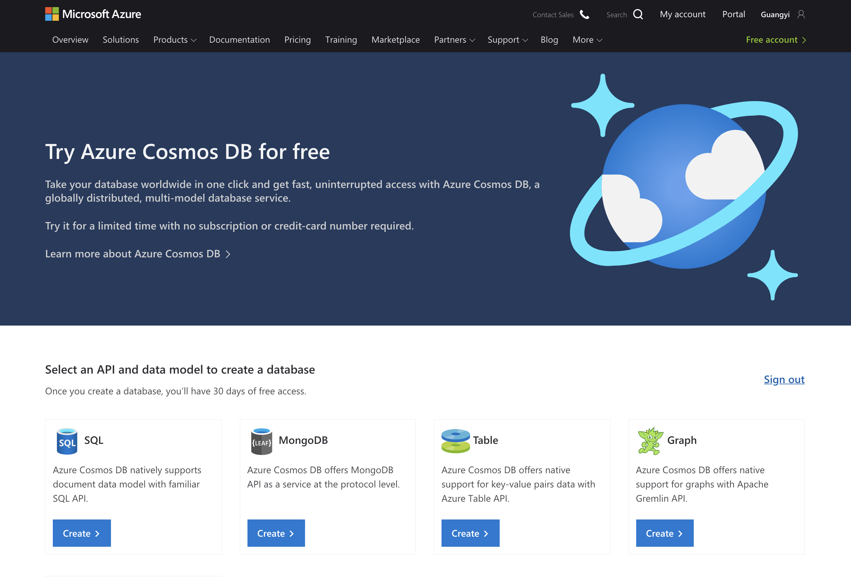
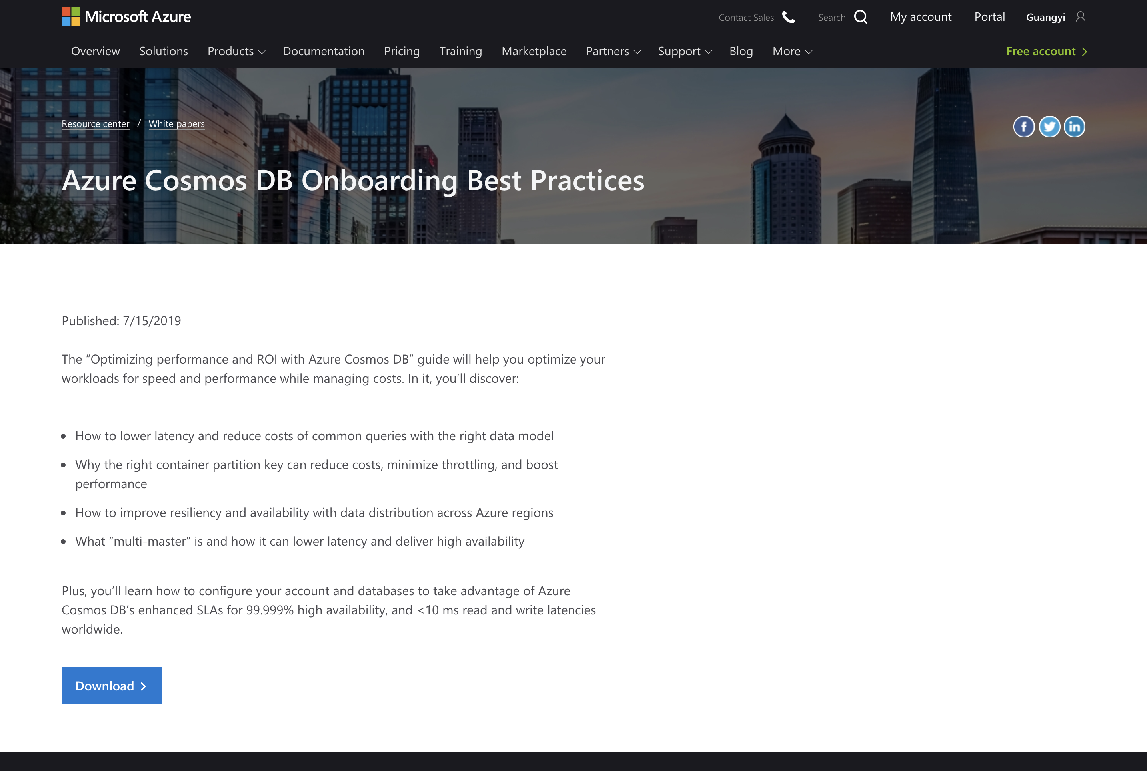
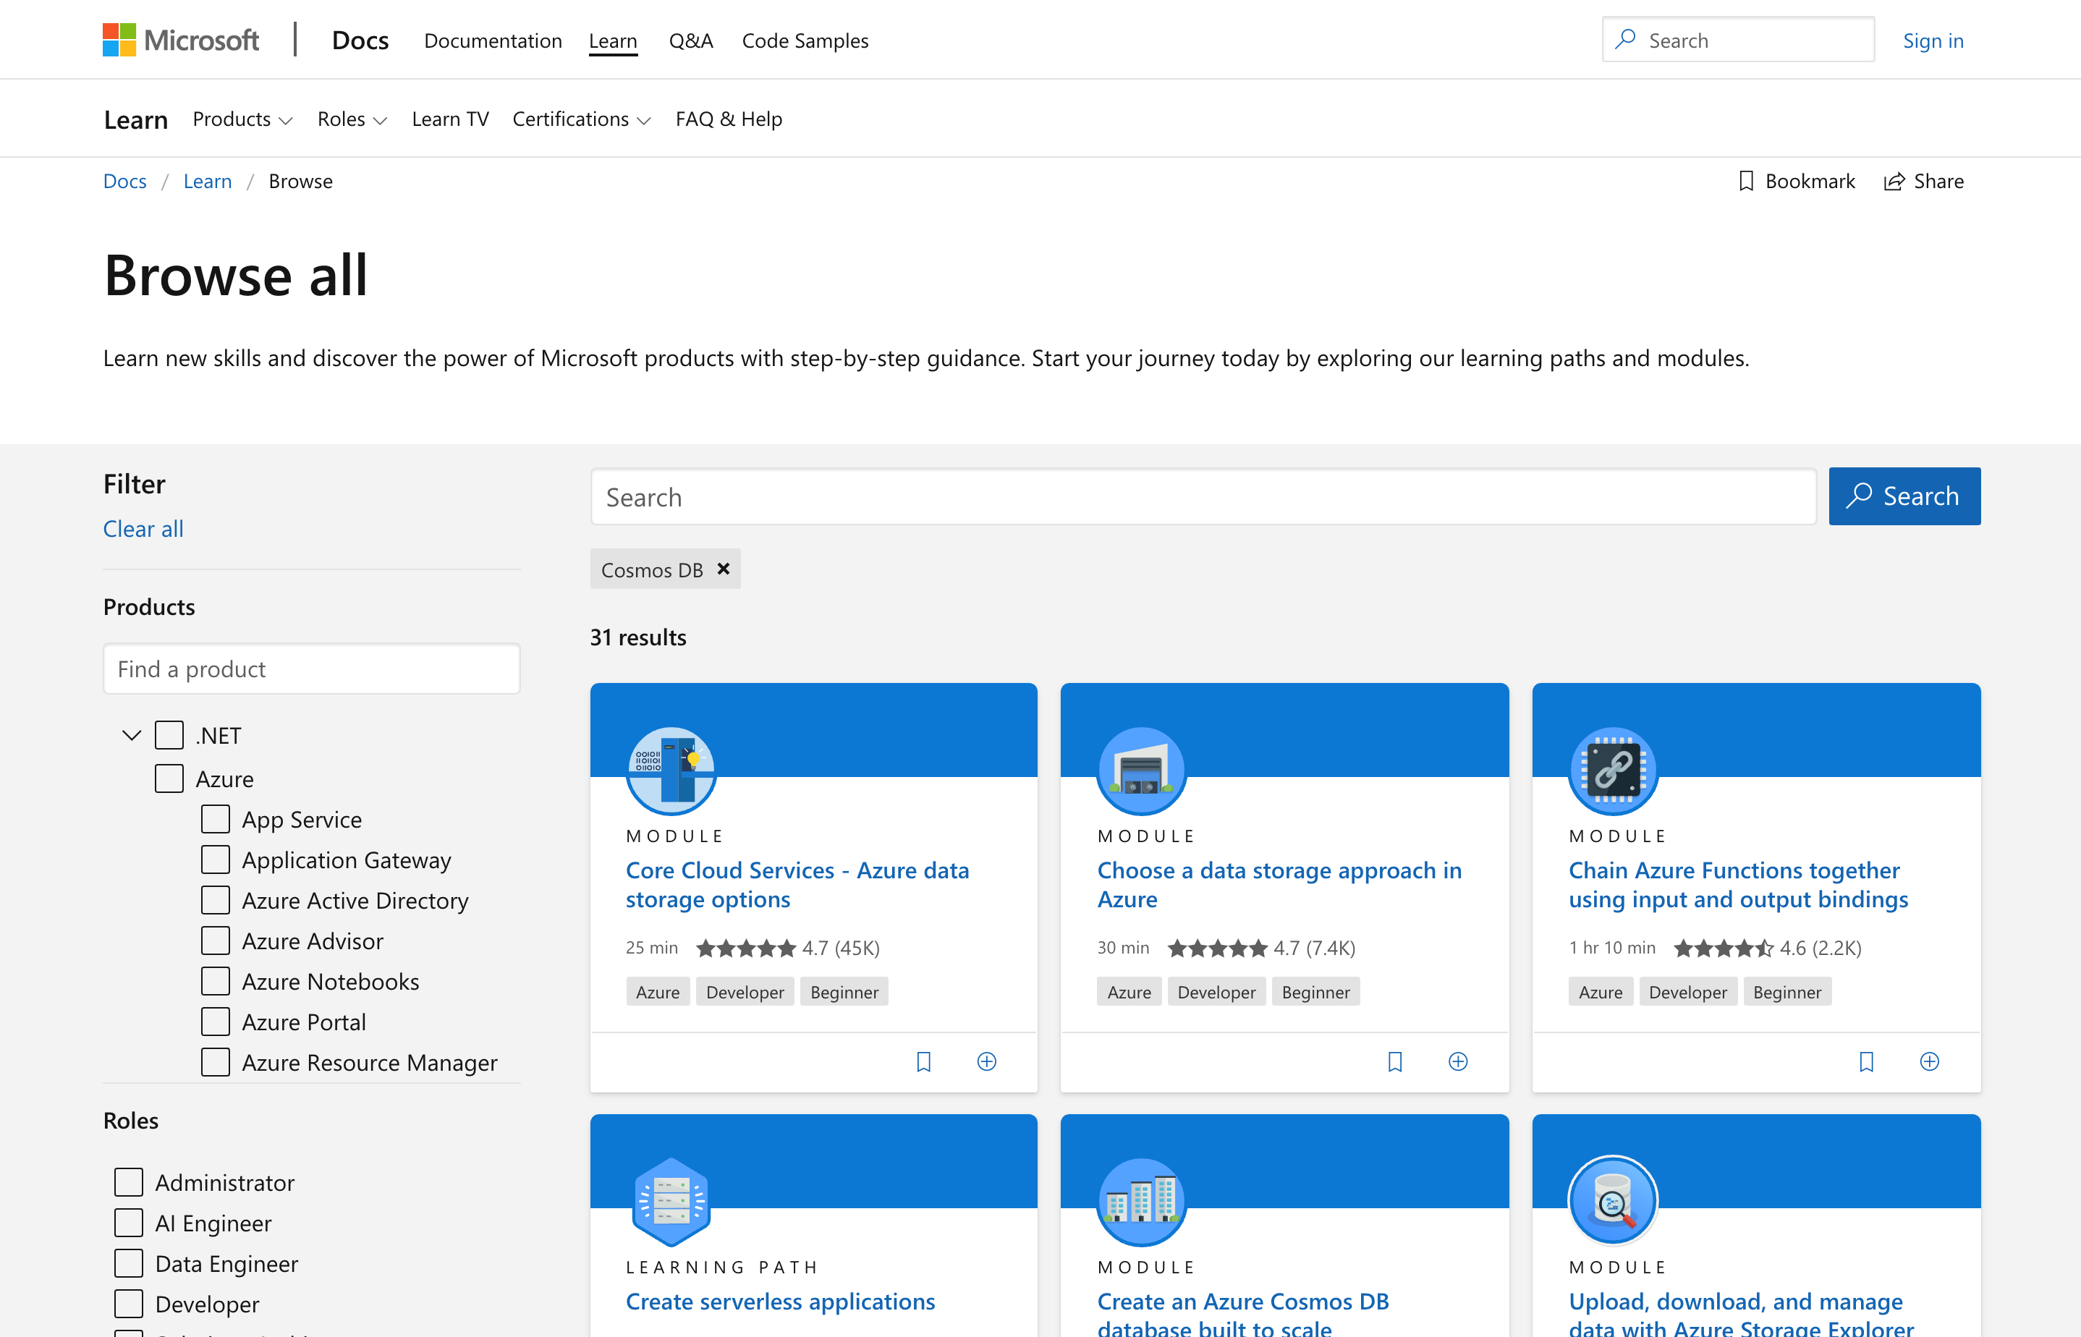
Ready to build modern apps on Azure Cosmos DB? Get started today!
Try Azure Cosmos DB free
Learn how to use Azure Cosmos DB through tutorials and best practices
Build your skills with Azure Cosmos DB learning modules

Slide 25


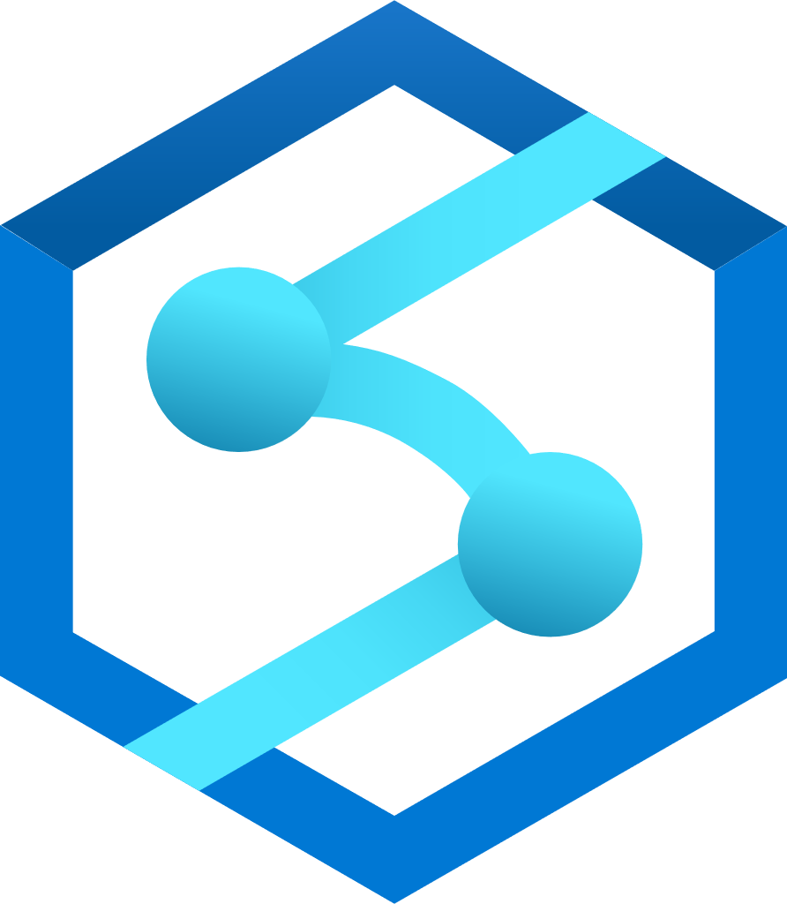
Stay agile with real-time telemetry on Azure Cosmos DB
Azure Iot Hub
Azure Databricks Spark (Structured Streaming)
Azure Cosmos DB (Hot)
(TTL = 90 days)
Azure API App (user facing app)
Azure Function (triggered via Cosmos DB change feed)
Azure Storage (Cold)
Azure Synapse Analytics (Cold)
(Summarized Telemetry)
Power BI Dashboard
Notes:
Get insights into operations, assets, and inventory to improve business performance and user experience. With Azure Cosmos DB, developers can easily ingest and manage high-velocity telemetry, fleet data, and supply chain data - in real-time, anywhere in the world, and in a cost-effective way.
Azure Cosmos DB is great for this use case because it offers:
Unlimited elastic and instant throughput
<10 ms read and write latency SLA
Autoscale pricing model matches capacity to demand
Auto-indexing of semi-structured data
Turnkey multi-master writes
99.999% availability SLA worldwide

Slide 26



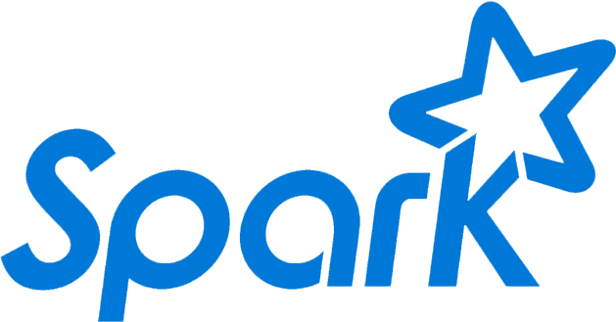
Personalize digital experiences with 360-degree customer view
Online Recommendations Service
HOT path
Azure Service Fabric
(Personalization Decision Engine)
Azure Cosmos DB
(distributed model store)
Shoppers
.com
(Product details page)
Azure Data Factory
(scheduled job to refresh persisted models)
Azure Event Hub
Azure Data Lake Storage
(offline raw data)
Apache Spark on Azure HDInsight
Offline Recommendations Engine
COLD path
Notes:
Leverage CRM and clickstream data throughout the user journey to deliver recommendations, personalized experiences, and more
Azure Cosmos DB is great for this use case because it offers:
Unlimited elastic and instant throughput
<10 ms read and write latency SLA worldwide
Turnkey multi-master writes
99.999% availability SLA worldwide
Auto-indexing of semi-structured data
Ingest high volumes of data from multiple sources

Slide 27

Put your data where your users are
Azure region A
<10 ms
Azure Cosmos DB (app + session state)
Azure Traffic Manager
Azure region B
<10 ms
Globally distributed across regions
Azure region C
<10 ms
Notes:
Deliver consistent, real-time, and always-on experiences anywhere with guaranteed performance.
Azure Cosmos DB offers:
One-click data distribution to any Azure region in the world
Turnkey multi-master writes
<10 ms read and write latency SLA for NoSQL data
99.999% high-availability SLA for NoSQL data
0 RPO and RTO
Choice of five data consistency models

Slide 28







Build multi-tenant apps that easily scale as your app grows
Tenant (customer)
Azure Cache
for Redis
2
Training & Predictive Experimentation
1
3
4
Data from multiple sources
Azure Kubernetes Service
Azure Cosmos DB for PostgreSQL
Azure Machine Learning
6
PostgreSQL Power BI Connector
5
Consumers
Notification Hubs
Power BI
Notes:
Support the growth of your SaaS business with a database built to scale out to millions of tenants, without you needing to re-architect your application.
Azure Cosmos DB for PostgreSQL
Offers high availability and tenant isolation
Elastically scales out to provide bigger app memory, compute and disk footprint, ensuring performance even as your app grows
Handles peak workloads and high numbers of concurrent users
Manages high volumes of transactions
Enables you to take advantage of Postgres reliability, rich data types, extensions, toolset, & expertise.

Slide 29
Optimize your Azure Cosmos DB costs
Getting started with Azure Cosmos DB is fast, easy, and economical
Free tier
Reserved capacity
Autoscale
Serverless
Develop/test applications or run small production workloads for free. Free tier provides the first 1000 RUs and 25 GB of storage for free.
Learn more
Reserve Azure Cosmos DB resources for either one or three years and get a discount on provisioned throughput. Save up to 65%.
Learn more
Eliminates the need to over-provision database infrastructure - pay only for what you use without worrying about capacity planning.
Learn more
Set your max throughput level and Azure Cosmos DB automatically and instantly scales throughput up or down within the designated range.
Learn more
Notes:
You can save on costs with Azure Cosmos DB free tier, reserved capacity, and serverless or autoscale account types.
Free tier: Available for all API accounts with provisioned throughput, autoscale throughput, single, or multiple write regions. Includes SLAs, high availability, turnkey global distribution in all Azure regions. Azure Cosmos DB free tier | Microsoft Learn
Autoscale provisioned throughput: you only have to configure the maximum amount of throughput you think your application will need. Then Azure Cosmos DB will automatically scale your throughput up and down to accommodate your application’s requirements within a range that spans from the maximum level you’ve configured down to 10% of that maximum. Autoscale delivers guaranteed throughput, guaranteed low latency, and guaranteed availability.
Ideal for:
Variable or unpredictable workloads
New applications
Infrequently used applications
Development and test workloads
Scheduled production workloads/queries
Serverless: Pure consumption model. Only RUs consumed by your request will get billed eliminating the need to provision capacity.
Ideal for:
Getting started with Azure Cosmos DB
Running applications with
bursty, intermittent traffic that is hard to forecast, or
low (<10%) average-to-peak traffic ratio
Developing, testing, prototyping and running in production new applications where the traffic pattern is unknown
Integrating with serverless compute services like Azure Functions

Slide 30
Optimize your Azure Cosmos DB costs
Tools to right-size your workload
Azure Monitor metrics
Azure Cosmos DB Capacity Calculator
Elasticity features to save costs
Azure Advisor
Analyze the performance, capacity and operational health of your Azure Cosmos DB workloads. Measure RU utilization, create alerts, and see which operations are using the most throughput.
Learn more
Get a quick estimate of your required RUs and workload costs, or tweak parameters (such as indexing policy and consistency level) for more accurate estimates.
Learn more
See personalized best practices and recommendations to help you improve cost, security, and performance in Azure Cosmos DB.
Learn more
Take advantage of idle throughput capacity to handle traffic spikes with Burst Capacity, reduce the number of partitions used with Partition Merge, and leverage other advanced cost-saving features.
Learn more
Notes:
Azure Cosmos DB also offers specific tools and features to save costs and improve performance.
Shared throughput across partitions: Azure Cosmos DB gives you the ability to redistribute your provisioned throughput across physical partitions. Redistributing throughput across partitions helps you achieve better performance without having to configure your overall throughput based on the hottest partition. Redistribute throughput across partitions (preview) in Azure Cosmos DB | Microsoft Learn
Partition merge: Minimizing partitions reduces the chance of rate limiting if a large quantity of data is removed from a container and RU/s per partition is low. Merge can help clear out unused or empty partitions, effectively resolving storage fragmentation problems. azure-docs/merge.md at main · MicrosoftDocs/azure-docs · GitHub
Burst capacity: With burst capacity, each physical partition can accumulate up to 5 minutes of idle capacity, which can be consumed at a rate up to 3000 RU/s. With burst capacity, requests that would have otherwise been rate limited can now be served with burst capacity while it's available. Burst capacity in Azure Cosmos DB (preview) | Microsoft Learn

Slide 31

Features of today's applications
Today’s applications are expected to do more than ever
Scale rapidly and elastically
Ensure high performance
Power real-time experience
Deliver business insights

Slide 32
NoSQL IaaS and on-premises offerings don’t meet the moment
On-premises and IaaS NoSQL options struggle with:
Poor performance and lack of data integrity
Tedious set-up and maintenance
Expensive and complex availability solutions
High costs from over-provisioning to achieve scale and high-maintenance databases

Slide 33
Azure Cosmos DB raises the NoSQL bar
On-premises and IaaS NoSQL options struggle with:
Azure Cosmos DB delivers:
Poor performance and lack of data integrity
Guaranteed performance at any scale
Tedious set-up and maintenance
Simplified app development
Expensive and complex availability solutions
Mission-critical ready
High costs from over-provisioning to achieve scale and high-maintenance databases
Fully managed and cost-effective

Slide 34


Migrate to cloud NoSQL with Azure Cosmos DB
Make data modernization easy with seamless migration of NoSQL workloads to cloud
Get all the perks of Azure Cosmos DB
using familiar database engines and tools
Instant, elastic, automatic, and limitless scale
Data replication across any Azure region
Guaranteed data consistency and throughput
<10ms latency on Azure Cosmos DB for NoSQL
NoSQL
MongoDB
Supports all claims and SLAs
Near-real time insights with Azure Synapse Link on Azure Cosmos DB for MongoDB and NoSQL API
Languages of your choice with SDKs for .NET, Java, and Python
Turnkey multi-master writes enabled by a click of a button
Industry-leading 99.999% availability worldwide SLA
Table
Fully managed database service automatically handles all maintenance and updates
Autoscaling removes the need for provisioning capacity
Cost-effective serverless database operations model responds to app patterns, is ideally suited for small, spiky workloads on Azure Cosmos DB for MongoDB and NoSQL
Auto-indexing capabilities on Azure Cosmos DB for NoSQL

Slide 35
Azure Cosmos DB for NoSQL
The native API for Azure Cosmos DB offers a view of your data that resembles a traditional NoSQL document store with capabilities like auto-indexing and <10ms latency
Premium capabilities
Instant, elastic, automatic, and limitless scale
Data replication across any Azure region
Guaranteed data consistency and throughput
<10ms latency SLA
Near-real time insights with Azure Synapse Link
Languages of your choice with SDKs for .NET, Java, and Python
Document data model
NoSQL
Turnkey multi-master writes enabled by a click of a button
Industry-leading 99.999% availability worldwide SLA
Fully managed database service automatically handles all maintenance and updates
Dynamic and limitless autoscaling for unpredictable workloads with high performance needs
Cost-effective serverless model for spiky workloads with moderate needs
Auto-indexing capabilities

Slide 36
Azure Cosmos DB for MongoDB
Support your MongoDB workloads with industry leading, financially backed SLAs that free you of database management tasks and lower TCO
Premium capabilities
delivered with migration made easy
Instant, elastic, automatic, and limitless scale
Data replication across any Azure region
Guaranteed data consistency and throughput
Compatible with v4.0, v3.6, and v3.2 for wire protocol support*
ACID-compliant multi-transaction support
Good pricing option for low-storage, high-throughput workloads
Migration tools to guide your journey:
Azure Database Migration Service online migration
Azure Database Migration Service offline migration
Striim continuous, real-time data flows
Near-real time insights with Azure Synapse Link
Languages of your choice with SDKs for .NET, Java, and Python
Document data model
Turnkey multi-master writes enabled by a click of a button
Industry-leading 99.999% availability worldwide SLA
Fully managed database service automatically handles all maintenance and updates
Dynamic and limitless autoscaling for unpredictable workloads with high performance needs
Cost-effective serverless model for spiky workloads with moderate needs
Drivers
Java 3.5+
Nodejs 3.5+
Python 3.15+
.NET
Ruby
MongoDB
Azure Cosmos DB:
API for MongoDB
MongoDB wire protocol
*MongoDB v4.0 supported as of March 2021
Notes:
Migration questions to ask include?
How do I survey my environment?
How do I assess the cost of migration?
How do I determine the feasibility of migration and understand potential blockers and work-arounds?
How do I provision the new environment?
Which tools are available to help me migrate? How do I use them?
After migration, how do I optimize for cost and performance?

Slide 37


Elastic scale with support for multiple APIs delivers insights to Bentley’s users
Challenge
With more than 60 major products and services with multiple data model, Bentley had MongoDB clusters running on virtual machines. The manageability and scalability of that solution quickly became a major concern.
Solution
Azure Cosmos DB delivered:
Flexibility with support for multiple APIs
Elastic scale to deliver actionable insights to users
Services across multiple regions
“We see great potential for Azure Cosmos DB in our products…. Building a flexible, scalable data layer with Azure Cosmos DB will enable us to deliver actionable insights to our users.”
Phil Christensen
Senior Vice President for Reality Modeling and Cloud Services

Slide 38


Citrix makes apps and data secure and easy to access anywhere, at any time
Challenge
Citrix was using MongoDB databases to power a web portal identity system that was disjointed and didn’t perform well. It needed a single sign-on solution it could trust to stay available so customers around the world could be able to sign in anytime.
Solution
Azure Cosmos DB delivered:
Guaranteed 99.999% availability
<10 ms latency response times
Global scalability to handle more than 10 million Citrix users
Support for rich queries over automatically indexed data
“We needed a solution to support a mission-critical service that handles over 10 million Citrix users worldwide. Azure provides the necessary enterprise-grade SLAs and low-latency response times at high load to give us peace of mind.”
Tom Kludy
Principal Architect, Citrix
Notes:
#MongoDB, #migration, #autoindex, #ISV
https://customers.microsoft.com/en-us/story/citrix

Slide 39

Simple migration enables always-on, real-time threat protection
Challenge
The Advanced Threat Analytics’ center was using an on-premises instance of MongoDB as its main database. In developing the Azure Advanced Threat Protection center, a managed service in the cloud, Microsoft needed something more performant and scalable.
Solution
Azure Cosmos DB delivered:
Fully-managed database with automatic scaling and handling of maintenance and updates
Elastic scale of both storage and throughput to support 600% customer growth
Flexibility with support for both NoSQL API and Azure Cosmos DB for MongoDB
Ease of mind with 99.999% availability worldwide
“Azure Cosmos DB gives us everything we need to deliver an enterprise-grade security service that’s capable of supporting the largest companies in the world, including Microsoft itself.”
Yaron Hagai
Principal Group Engineering Manager

Slide 40
Azure Cosmos DB for Apache Cassandra
Support your Cassandra workloads with industry leading, financially backed SLAs that free you of database management tasks and lower TCO
Premium capabilities
Delivered with migration made easy
Instant, elastic, automatic, and limitless scale
Data replication across any Azure region
Guaranteed data consistency and throughput
Wire protocol support for Cassandra Query Language (CQL) v3.11
Migration tools to guide your journey*:
Use cqlsh COPY command
Use Spark
Languages of your choice with SDKs for .NET, Java, and Python
Columnar data model
Drivers
Java 3.5+
C# 3.5+
Nodejs 3.5+
Python 3.15+
C++ 2.9
PHP 1.3
Gocql
Turnkey multi-master writes enabled by a click of a button
Industry-leading 99.999% availability worldwide SLA
Azure Cosmos DB for Apache Cassandra
Cassandra wire protocol
Fully managed database service automatically handles all maintenance and updates
Dynamic and limitless autoscaling for unpredictable workloads with high performance needs
Cost-effective serverless model for spiky workloads with moderate needs
*Migration from Azure Managed Instance for Apache Cassandra coming soon

Slide 41


Symantec discovers 40% savings and more reliability by migrating
Challenge
Symantec was managing their storage and Cassandra databases within their own datacenters, which was both costly and time-consuming to prevision resources.
Solution
Azure Cosmos DB delivered:
Seamless migration with Azure Cosmos DB for Apache Cassandra
40% database management savings with elastic and automatic scaling
<10 ms latency
Ease of mind with 99.999% availability worldwide
“Now we can focus on our core competency, and we can go back to writing security components rather than managing databases.”
Mike Shavell
Technical Director/Architect

Slide 42
Azure Cosmos DB for Gremlin
Store massive graphs with billions of vertices and edges with the API based on Apache TinkerPop using Gremlin query language
Premium capabilities
Instant, elastic, automatic, and limitless scale
Data replication across any Azure region
Guaranteed data consistency and throughput
Languages of your choice with SDKs for .NET, Java, and Python
Graph data model
Turnkey multi-master writes enabled by a click of a button
Industry-leading 99.999% availability worldwide
Fully managed database service automatically handles all maintenance and updates
Dynamic and limitless autoscaling for unpredictable workloads with high performance needs
Cost-effective serverless model for spiky workloads with moderate needs

Slide 43
Azure Cosmos DB for Table
Applications written for Azure Table storage can migrate to Azure Cosmos DB by using the Table API with no code changes and take advantage of premium capabilities
Premium capabilities
Instant, elastic, automatic, and limitless scale
Data replication across any Azure region
Guaranteed data consistency and throughput
Languages of your choice with SDKs for .NET, Java, and Python
Key-value data model
Table
Turnkey multi-master writes enabled by a click of a button
Industry-leading 99.999% availability worldwide SLA
Fully managed database service automatically handles all maintenance and updates
Dynamic and limitless autoscaling for unpredictable workloads with high performance needs
Cost-effective serverless model for spiky workloads with moderate needs

Slide 44

PostgreSQL deployment options
New
Flexible Server
Azure Cosmos DB for PostgreSQL
Single Server (Legacy)
Fully-managed PostgreSQL database service with zone redundant-HA, maximum control and a simplified developer experience
Example use cases
Transactional and operational analytics workloads
Apps requiring JSON, geospatial support, or full-text search
Cloud-native apps built with modern frameworks, lower TCO, and latest PostgreS versions
​High-performance apps utilizing zone co-location for low latency
Distributed PostgreSQL with the performance, elasticity, and scalability of Azure Cosmos DB
Example use cases
Scaling PostgreSQL multi-tenant, SaaS applications
Real-time operational analytics
Building high throughput transactional apps
Fully-managed, single-node PostgreSQL database service with zonal HA
Example use cases
Cloud-native apps built with modern frameworks
Apps that don’t require granular control or custom configuration settings
Transactional and operational analytics workloads
Azure Arc enabled PostgreSQL Hyperscale (Preview) is now in preview as part of Azure Arc enabled data services. Benefit from Azure cloud innovations and a unified hybrid management experience for Hyperscale data workloads operating on any infrastructure with or without a direct connection to the cloud.

Slide 45


Azure Cosmos DB for PostgreSQL
New
Build cloud-native apps with distributed PostgreSQL and benefit from the performance, elasticity, and scalability of Azure Cosmos DB. Start free, grow to any scale.
Multi-tenant SaaS
Open source PostgreSQL at the core
Build apps at any scale
Geo-distributed
Real-time operational analytics
Latest community-edition PostgreSQL ships within 1 day of release.
Build on a single node and scale out to clusters as your workload evolves, without any changes to your application.
Deploy cross-region read replicas with low latency and geo-redundancy.
Cloud-native apps
High throughput transactional apps
Optimized for SaaS applications
Broad ecosystem support
Start free today
Geo-spatial aware apps
Build cost-effective multi-tenant SaaS applications with high availability and tenant isolation.
50+ extensions, such as PostGIS for geospatial, HLL for HyperLogLog, pg_cron for running scheduled jobs, and more.
Get started for free on Azure Cosmos DB with no credit card or Azure subscription required.

Slide 46
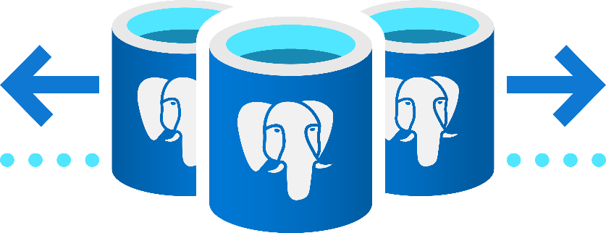

Limitless scale with Azure Cosmos DB for PostgreSQL
Scale out horizontally
Blazing performance
Run on any infrastructure
Stay current with PostgreSQL innovations
Break free from the limits of single-node Postgres & scale out across 100s of nodes
Start small with a scale-out ready database using Basic Tier
Ingest & query your database in real time, with sub-second responses across billions of rows
Option to reduce your storage footprint with columnar compression
Choose the infrastructure that suites your needs with Azure Arc
Developed as an open-source extension, leverage all your PostgreSQL expertise and its latest innovations, including support for Citus 11

Slide 47
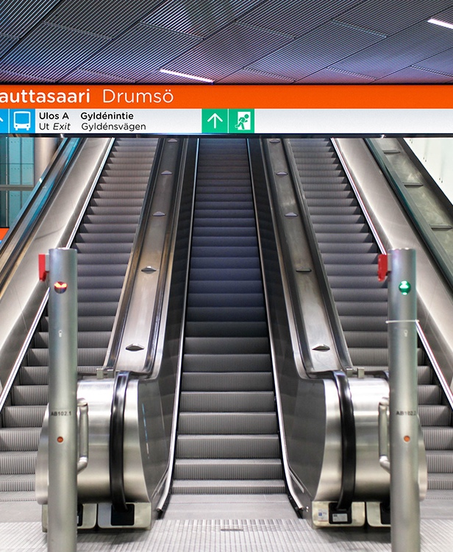

Transit authority improves traffic monitoring while lowering operational costs
Challenge
Helsinki Region Transport Authority (HSL) is responsible for more than half of all public transportation in Finland, including a network of over 2,000 buses, trams, Metro trains, ferries, and commuter trains. Managing this complex network efficiently proved to be a challenge.
Solution
Azure Cosmos DB for PostgreSQL delivered:
Managed, high-performance scaling
Instantaneous response times with no query delays
Reduction of operational cost by over 50%
Stronger monitoring to ensure that vehicles stay on schedule
“Along with much better performance, moving to Hyperscale has reduced operational costs by over 50 percent.”
Sami Räsänen Product Owner and Team Lead
Notes:
https://customers.microsoft.com/en-us/story/845146-transit-authority-improves-traffic-monitoring-with-azure-database-for-postgresql-hyperscale

Slide 48

Microsoft Windows chooses Azure Cosmos DB for PostgreSQL
Challenge
Windows was looking for a cloud-based database that could support the volume and velocity of transactions in its diagnostic metrics and improve customer experience during updates.
Solution
Azure Cosmos DB for PostgreSQL delivered:
Real-time analytics: 95% queries execute in <4s
Fast response times: 75% of queries are <200ms
Support for massive query volume: >6m daily

Slide 49
How do Azure DB for PostgreSQL and Azure Cosmos DB for PostgreSQL differ?
Azure DB for PostgreSQL – Flexible Server
Azure Cosmos DB for PostgreSQL
Migrate or modernize PostgreSQL apps & data
AI-powered performance optimization
Azure IP Advantage Integration
99.99% availability SLA (with zone redundancy)
Mission-critical apps utilizing zone redundancy and fine-grained maintenance scheduling
Apps requiring variable compute capacity to optimize costs
Build cloud-native apps at any scale
Fast, high-performance scale out and elasticity
Start free on a single node and grow to any scale
99.95% availability SLA
Multi-tenant SaaS apps
Real-time operational analytics
High throughput transactional apps
Notes:
Add in SLAs

Slide 50
App and Data Innovation Programs for customers
Take advantage of Azure programs and offers to build or modernize data and apps.
To…. | Use…
Build or modernize Java applications with Azure managed databases | Java Apps on Azure Customer Credit Offer (Java on Azure)
Build cloud-native applications or modernize existing apps and databases | Azure Migration and Modernization Program (AMMP)

Slide 51
Java Apps on Azure Customer Credit Offer details Build or modernize Java apps to save up to 30% on Azure Spring Cloud and up to 20% on Azure managed databases and other managed app services*
Starter offer
Offer | Azure Credit Offer (ACO) | Annualized usage estimate | Eligibility requirements
Starter | Engagement on any managed app services: $4K Engagement on Azure Spring Cloud: $6K | >$25K (including Azure Cosmos DB or other managed databases) | Stage = Commit >$25K estimated annualized usage for engagement <Annualized estimate is for the entire solution > MSX milestone must be in “Java on Azure Sales Program” with correct workload tag
Accelerate offer
Offer | Azure Credit Offer (ACO) | Annualized usage estimate | Eligibility requirements (all offers)
Accelerate - Small | Engagement on any managed services: $7.5K Engagement on Azure Spring Cloud: $11.3K | $25K-50K | Eligibility requirements for all offers Stage = Onboard or beyond >$25K estimated annualized usage for milestone MSX milestone must be in “Java on Azure Sales Program” with correct workload tag Attach customer solution architecture Show calculation details for estimated usage annualized (across Azure)
Accelerate - Medium | Engagement on any managed services: $15K Engagement on Azure Spring Cloud: $22.5K | $50K-100K
Accelerate - Large | Engagement on any managed services: $25K Engagement on Azure Spring Cloud: $37.5K | $100K-150K
Accelerate - Extra Large** | Engagement on any managed services: up to 20% Engagement on Azure Spring Cloud: up to 30% | >$150K
*other managed services include AKS, ARO, App Service, Container Apps
**For extra large deals >150k, Needs more details with ACO up to percentage mention with upper cap of 100K.
Microsoft Confidential
Notes:
https://Aka.ms/JavaOnAzureOffers
Standard guidelines for deal eligibility
Customer must be modernizing a new or incremental Java application currently running on-prem, IaaS or another cloud.
Customer must select one of following hosting service for the application: Spring Cloud, AKS, App Service, ARO, Container Apps
The total deal amount must be greater than $25K annually Customer deal must exist in MSX as an active engagement with "Java on Azure" Sales program and appropriate MSX tag.
All managed customers are eligible, including public sector.
Max ACO requested must not be greater than 100k per year and only for the rolling 12 months.
This offer NOT be combined with the AMMP ACO offer.
AMMP ECIF offer at 1:5 is still applicable to engage with Advanced Specialized Partners.
Approval timing
Starter offer: Approved soon after request is submitted and approval criterion is met.
Accelerate offer: Approved soon after request is submitted and approval criterion is met.

Slide 52
Azure Migration and Modernization Program (AMMP)
Get support for your app development, data migration, and app and data modernization needs across Data, Infrastructure, and Apps
Proven approach: Microsoft Cloud Adoption Framework and Well Architected Framework
Cost-effective offers and incentives
Technical skill building
Free tools/ automation: Azure Migrate
In-depth assistance from FastTrack for Azure engineers
Expert help from specialized services partners
Support environmentally sustainable initiatives
Migrate and modernize your app and data workloads
Modernize apps + supporting database backends (incl. SQL Server, MySQL, PostgreSQL, NoSQL)
Microsoft investment in your project → partner funding + Azure credits + technical skilling
Learn More | Azure.com/AMMP
Work with your partner or Microsoft account team to get started
Notes:
AMMP continues to be our hero corporate program for all things migration and modernization in FY23.
The Azure Migration and Modernization Program (AMMP) helps simplify and accelerate your cloud adoption journey. AMMP has helped 1000s of customers successfully unlock the benefits of cloud with the right mix of expert help and best practices at each step. With AMMP, you can leverage prescriptive step by step guidance -- from assessments to planning to execution.
AMMP provides offers and incentives based on your need – be it subsidized services from partners or Azure credits to help offset transition costs as you migrate.
AMMP enables you to deliver sustainable outcomes for your company – our 2020 environmental sustainability report shows you can also achieve up to 93 percent more energy efficiency and up to 98 percent more carbon efficiency by moving to the cloud (vs. on-premises).
AMMP helps you move with confidence by skilling up your organization as well as direct assistance from Azure engineers and specialized partners.

Slide 53
Count on a proven practice
Migrate and modernize your data estate
Define strategy and Plan your migration
Microsoft Cloud Adoption Framework
Assess your environment
Azure Migrate
Ready
Azure Migration and Modernization Program
Adopt
Azure Migrate
Notes:
Get started Today with the support of Microsoft practices, tools and programs that can help accelerate your journey to adopt Azure and realize benefits faster

Slide 54






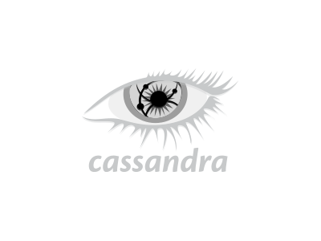


Tools and services for your migration journey
On-premises
Other clouds
Microsoft Azure
Assessment
Migration
Azure Migrate, SQL Server Migration Assistant, Data Migration Assistant, Database Experimentation Assistant
Azure Database Migration Service, Azure SQL Migration extension in Azure Data Studio
Notes:
We have a portfolio of migrations tools based on your desired migration source and migration targets

Slide 55


FY23 AMMP: Build or modernize apps with Azure data
Criteria:
Project: Create cloud native apps or modernize application data to Azure Cosmos DB (along with compute to Azure App Service, Azure Kubernetes Service, Azure VMs, and Azure Spring Cloud). All details live on GearUp.
AMMP Offer:
Create cloud native apps or modernize NoSQL data to Azure Cosmos DB
Partner Led + FastTrack for Azure engineers (Advanced offer only)
Assess & Plan resources:
Solution Assessment, Cloud Adoption Framework Workshop, and Pilot/POC (up to $35K partner funding and $5K Azure credits)
Migrate & Modernize resources:
Landing Zone and Deployment Activity (up to $500k partner funding, Azure credits and FastTrack for Azure (Advanced only)) ​
Skilling: Free or discounted Azure technical skilling and exams
Nomination Form
Nominate your Strategic, Major, or SMC customer to AMMP via the OneAsk nomination form
Partner Requirement
Partners will need to have an Advanced Specialization in Modernization of Web Applications to Microsoft Azure or Advanced Specialization in Kubernetes on Microsoft Azure
Workload Eligibility
Standard offer: Min. project size $25k/year Azure consumption
Advanced offer: Min project size $100k/year Azure consumption up to $2.5M/year
Should be completed in 12 months
Assess & Plan: Support for Developing Your Cloud Adoption Plan​
Project Size​ | Packaged Assess and Plan Activities​ |  | Partner Funding​ | Azure Credits​ | Azure Credits​ |  | Engagement Assistance​
>$25K/year ACR​ | Solution Assessment (Ind. Migration & deployment plan Cloud Adoption Framework Workshops​ Pilot/POC +”foundational” Landing Zone |  | Up to $35K​ | UP to $5K Azure Access Sandbox ​ Or​ Azure Credits​ | UP to $5K Azure Access Sandbox ​ Or​ Azure Credits​ |  | Microsoft Solution Assessment Specialist (SAS) Assigned​ Free Access to 1st or 3rd Party Tools for Assessment​ Partner-led Engagement (w/ incentives) for all phases​
Migrate and Modernize: Support to Accelerate your Azure Deployment ​(Standard and Advanced Offers)​
Project Size​ |  | Landing Zone (Enterprise Scale)​ | Deployment Activity​ |  | Partner Funding​ | Azure Credits​ |  | Engagement Assistance​
Standard Offer:​ $25K-$100K/year ACR​ |  | Single milestone reflective of all above activities up to the max funding.​ |  |  | Up to $20K​ | Up to $5K​ |  | - Partner-led​ - Technical Skilling​
Advanced Offer: >$100K/year ACR​ |  | Recommend Allocating ~30% of Funding​ | Recommend Allocating ~70% of Funding​ |  | Up to $500K​ | Up to $100K ​ |  | - Partner-led + FastTrack for Azure​ - Technical Skilling​
Microsoft Confidential
Notes:
We recently introduced a new offer to the Azure Migration & Modernization Program to support the modernization of data to Azure Cosmos DB.
We will provide technical assistance and project management from FastTrack to migrate those databases and the associated compute into Azure Cosmos DB and one of Azure’s compute services.
Microsoft provides ECIF funding to partners. We’ll also provide Azure Credits and technical skilling to help the customer get up and running.
One last note on the offer – these migrations will be conducted by partners with an Advanced Spec in Web App Mod – have demonstrated skills with Azure Cosmos DB, DevOps and our migration tooling. Also have passed a 3P audit showing customer success.

